Slide 1
Covid Related Twitter Activity
Final Project: MSCA 31013-2 Big Data Platforms
Muhammad Ali Ahmad

Slide 2
Agenda
Executive Summary and Meaningful Insights
Methodology and Source Data Overview
Tweet Clean Up and Filtering
Exploratory Data Analysis
Author Identification
Location Analysis
Timeline Analysis
Message Uniqueness Analysis
Conclusion and Actionable Recommendations

Slide 3
Executive Summary and Meaningful Insights
A positive correlation was observed between Covid related tweets and the number of Covid related infections and deaths.
Twitter can be used as a credible source for anticipating and forecasting Covid Surges by government and health agencies for countries with significant tweet volume.
The most influential twitter accounts with Covid related tweets belonged to news agencies and media groups.
My findings and recommendations are predominantly applicable to the United States, the only country with more than 30,000 Covid related tweets given my filtering parameters.
A stronger correlation between covid related tweets and covid cases was found as compared to that between covid related tweets and covid deaths.

Slide 4
Methodology and Source Data Overview
Initial data evaluation was done through:
Importing all available data and observing the schema in our notebook
Printing key columns and further inspecting data nested within the JSON format
Cross-checking feature importance by examining twitter projects online
Studying the data dictionary published by twitter itself
Twitter data is stored with an extensive list of “root-level” attributes, which incorporate majority of the fundamental features required for data analysis.
More elaborate data was obtained through parsing the child-level attributes in JSON files.
Data dictionary: https://tinyurl.com/27wmyjcu

Slide 5
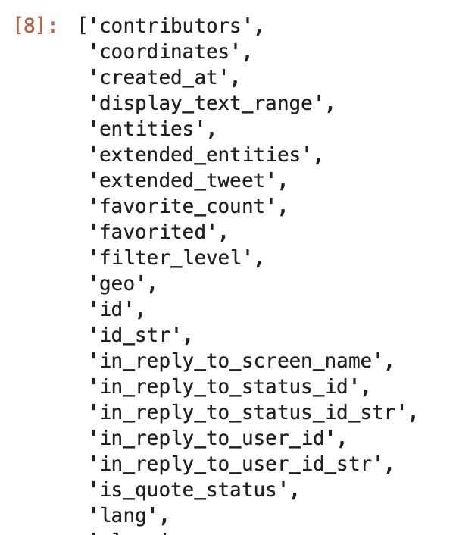
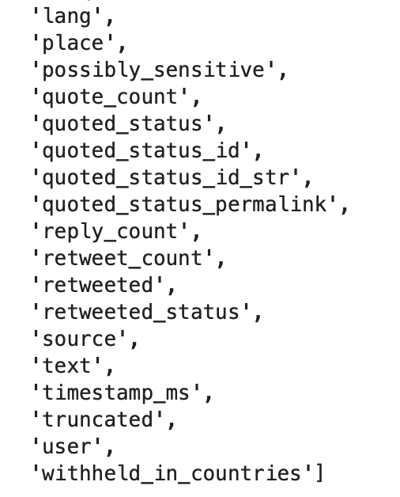
Methodology and Source Data Overview
Key Columns for our Analysis:
User.name
User.id
User.folowers_count
Text
Created_at,
Retweeted_status
Retweet_count
Place.Country

Slide 6

Data Cleaning: Filtering and Transforming data
Data Cleanup:
Filtering was carried out for pertinent Covid related tweets for location analysis and removing noise within data.
To facilitate covid analysis at a location level, null values from the column place.country were removed
Transformed the Created_at column to extract year, month and date
Keywords Used to filter Covid Related Tweets:
Corona
Covid
Pandemic
Delta
Omicron
Alpha

Slide 7
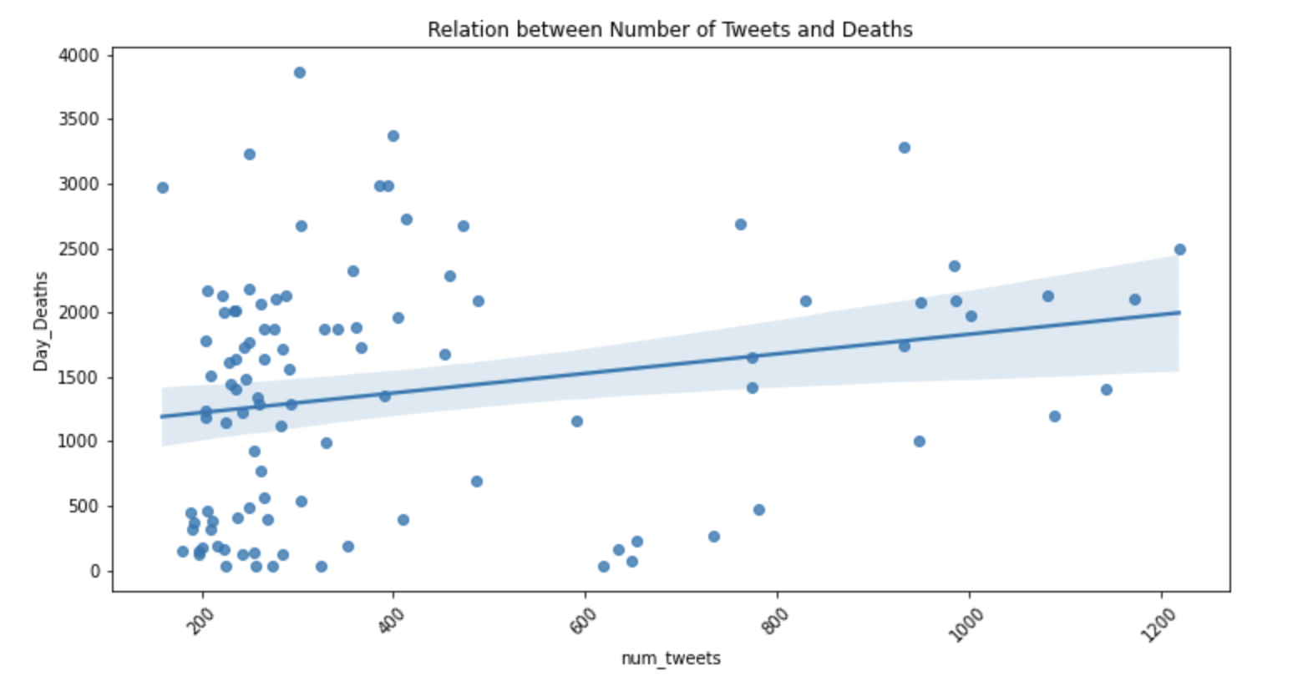
Exploratory Data Analysis
Observing a strong correlation between number of death and covid related tweets

Slide 8
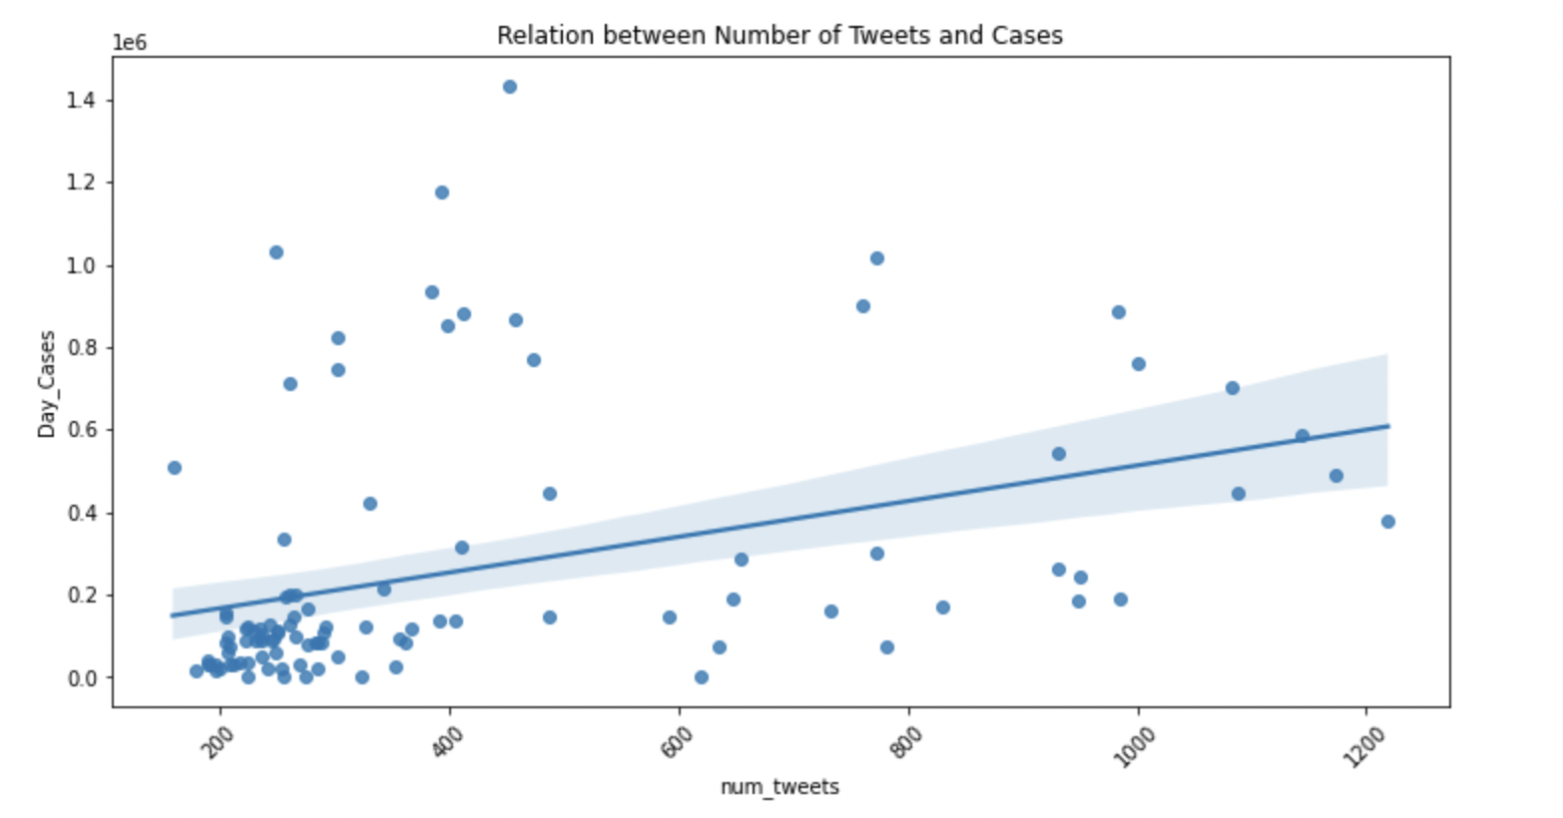
Exploratory Data Analysis
Observing an even stronger correlation between number of cases and covid related tweets

Slide 9
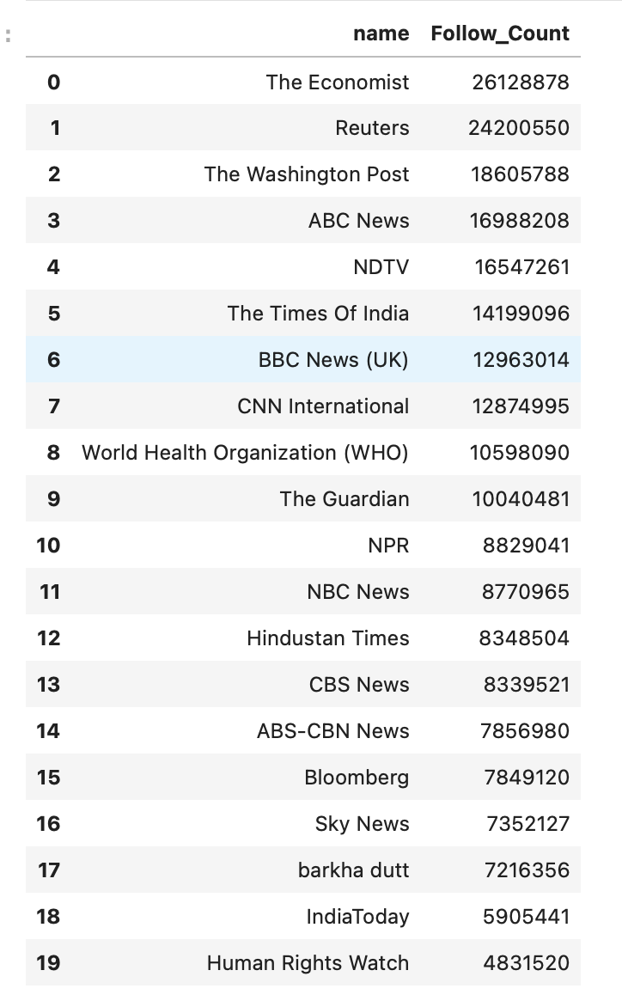
Author Identification
Accounts with the greatest number of followers:
It was imperative to understand what kind of accounts were largely tweeting about Covid and the nature of these accounts.
Out of the top 20 twitter accounts, almost all of them were media outlets or news reporting agencies with the following exceptions:
World Health Organization (WHO)
barkha dutt - Independent Journalist
Human Rights Watch

Slide 10
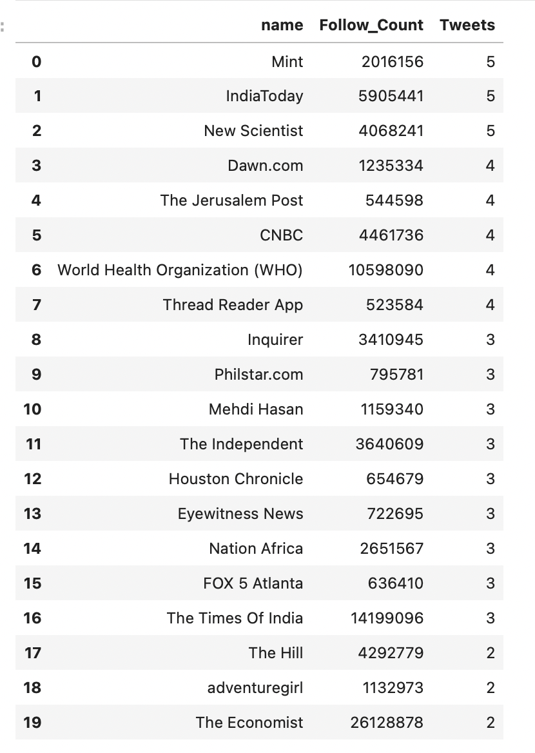
Author Identification
Accounts with the greatest number of tweets:
When filtering for accounts with the greatest number of tweets, it was observed that a lot of accounts had limited followers.
The analysis was repeated after creating a threshold for accounts with more than 500,000 followers to increase credibility.
This method of author identification returned a greater mix of geographical diversity among news agencies.

Slide 11

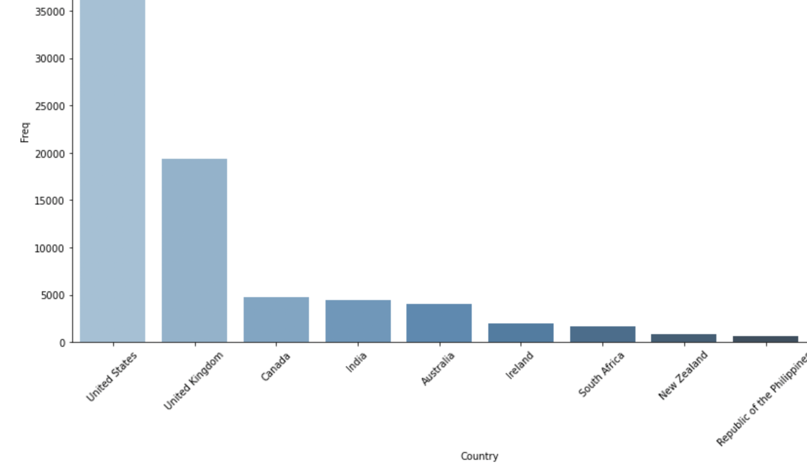
Location Analysis
Number of Covid Related Tweets Per Country:
The variable place.country was used to observe the geographical distribution of the data. The column showed that the highest number of tweets were from the United States, while majority of rows had missing values.

Slide 12
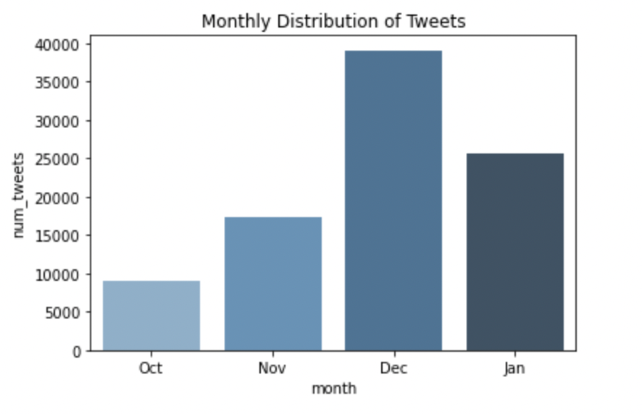
Timeline Analysis
The data was sourced from tweets between October 2021 and January 2022. There was a surge in Covid related tweets in December.

Slide 13
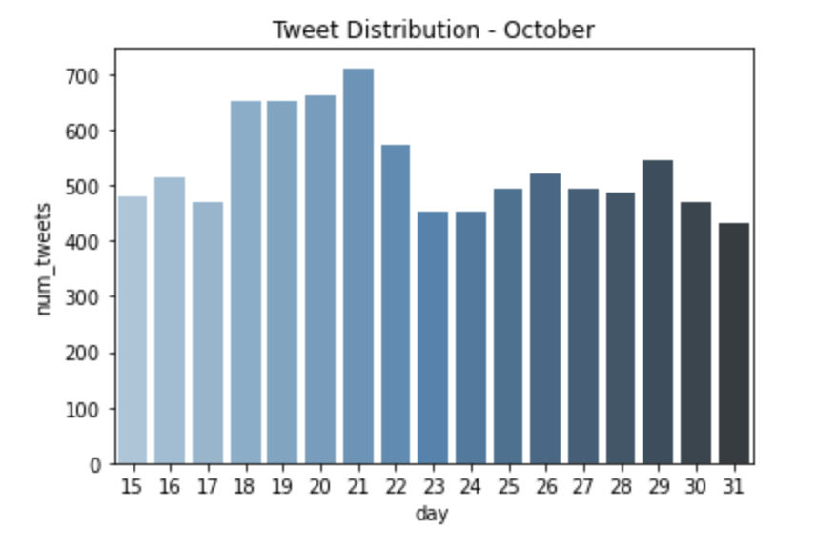
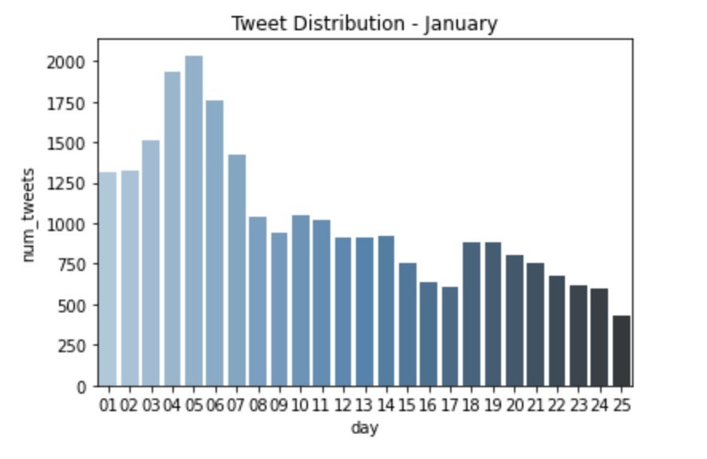
Timeline Analysis - Monthly Overview

Slide 14
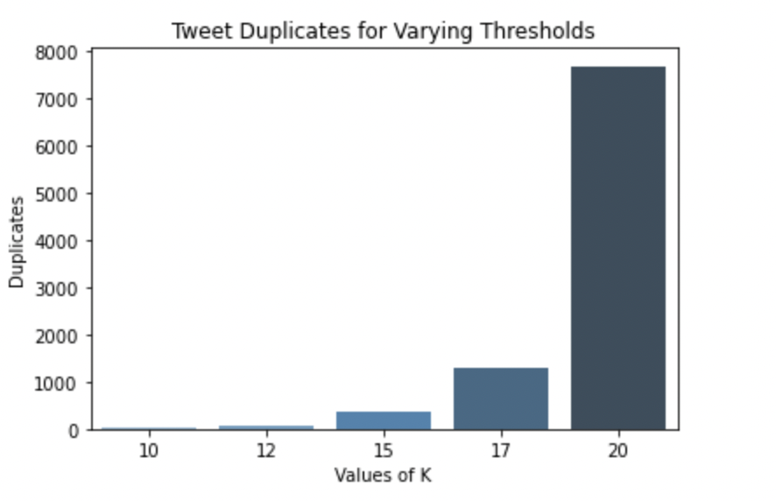
Message Uniqueness Analysis
To observe the message uniqueness analysis or duplication of tweets, there were two available methods. LSH was computationally expensive for PySpark, and Simhash was used.
The algorithm becomes increasingly restrictive with increasing values of k.

Slide 15
Conclusions and Actionable Recommendations
Twitter activity can be used to predict covid cases:
Conclusion: For the examined sample, surge in tweets related to Covid were positively correlated with the number of cases for Covid.
Limitation: The analysis would be more scalable and relevant if the location column was populated better in the data generating process.
Future Work: Utilize NLP on the text columns and geographical columns to better impute missing values within the location column.

Slide 16
Conclusions and Actionable Recommendations
Utilizing such algorithms at a government level and with health organizations:
Conclusion: Digital data streams such as those of Twitter, Facebook, and Instagram can be used to provide early outbreak signals and install preemptive measures.
Limitations: There is an ongoing need within predictive analytics to obtain a more representative sample of data while ensuring that there is limited noise to obtain actionable insights. With the availability of more time, intellectual and computational resources, the tweets can be examined further to perform text analysis and ensure the most representative sample is obtained. The retweet count of tweets was always returning 0, and could be better populated.
Future Work: Deploy algorithms built by Data Science teams to automate tweet detection and inform relevant agencies.

